Slide 1
TELECOM CHURN PREDICTION ANALYSIS

Slide 2
CHURN PREDICTION
The crucial profit of any business involves in attracting new customer and retaining their old customers.
Customer attrition, also known as customer churn, is the loss of clients or customers.

Slide 3
BACKGROUND
Telephone service companies, Internet service providers, pay TV companies, insurance firms, and alarm monitoring services, often use customer attrition analysis and customer attrition rates as one of their key business metrics because the cost of retaining an existing customer is far less than acquiring a new one.
VOLUNTARY CHURN
Voluntary churn occurs due to a decision by the customer to switch to another company or service provider
INVOLUNTARY CHURN
Involuntary churn occurs due to circumstances such as a customer's relocation to a long-term care facility, death, or the relocation to a distant location

Slide 4
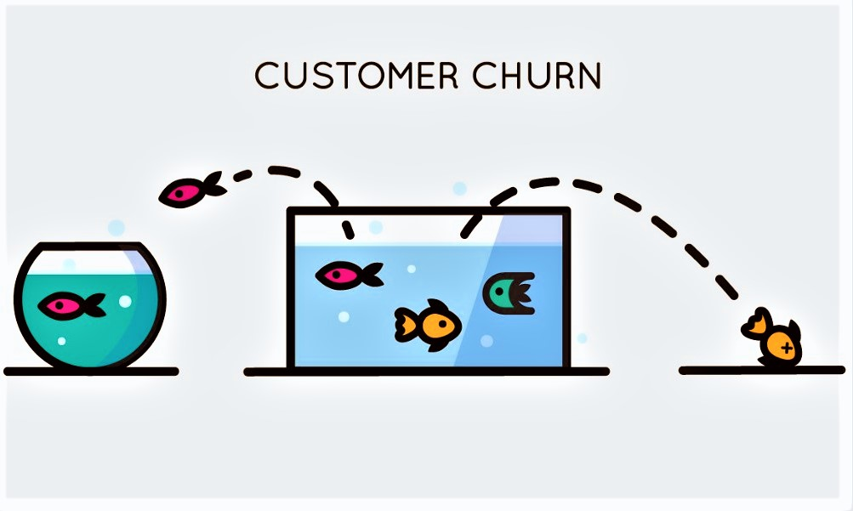
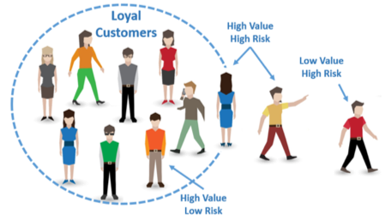
GOAL FOR PREDICTION
To Predict the behavior of the customer and develop plans to retain the customers who may churn
The Prediction is used to find the customers, that might switch telecom service providers
Make recommendation / actions to be taken to retain these customers based on the common criterion among the people who churn.

Slide 5

BUSINESS PROBLEM
For our Business Problem we have taken our dataset from Kaggle.
The Dataset contains about 7043 rows of customer data
There are about 20 columns of independent variables which contribute for the dependent variable Churn
$20K
10%
45K

Slide 6
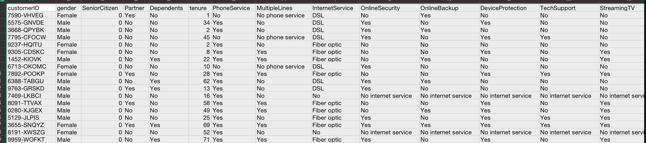
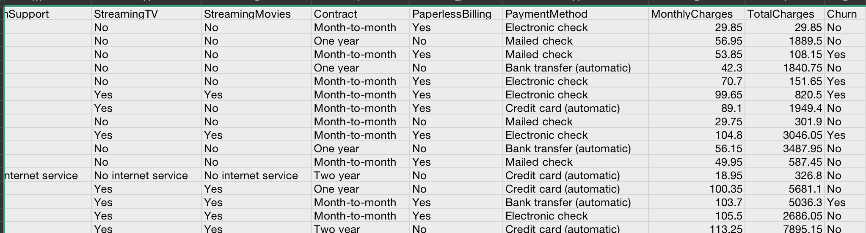
DATASET OVERVIEW

Slide 7
DATA OVERVIEW - CONTD
The Dataset has both quantitative and qualitative variables contributing to churn
The Dependent variable Churn is binary variable (yes / No)
There are about 6 binary independent variables
11 categorial variables are factored in
3 Continuous Variables

Slide 8
INDEPENDENT VARIABLE
Binary Variables
Gender
Senior Citizen
Partners
Dependents
Phone Service
Paperless Billing
Categorial Variables
MultipleLines
CustomerID
InternetService
OnlineSecurity
OnlineBackup
DeviceProtection
TechSupport
StreamingTV
StreamingMovies
Contract
PaymentMethod
Numerical Variables
Tenure
Monthly Charges
Total Charges

Slide 9
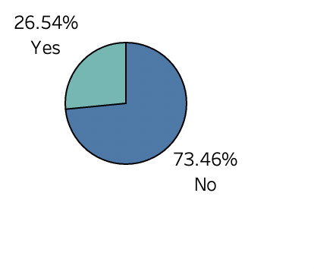
CLASS IMBALANCE - BIAS
The Given dataset with 7023 rows has about 73.46% of data of the customers who does not churn - Loyal Customers
The Data is biased as a major portion of the data has a prediction of churn to be NO.
From the chart it is clear that 26.54% of the customers churn
The goal is to reduce the churn percentage.
Approximate2000 customers churn

Slide 10
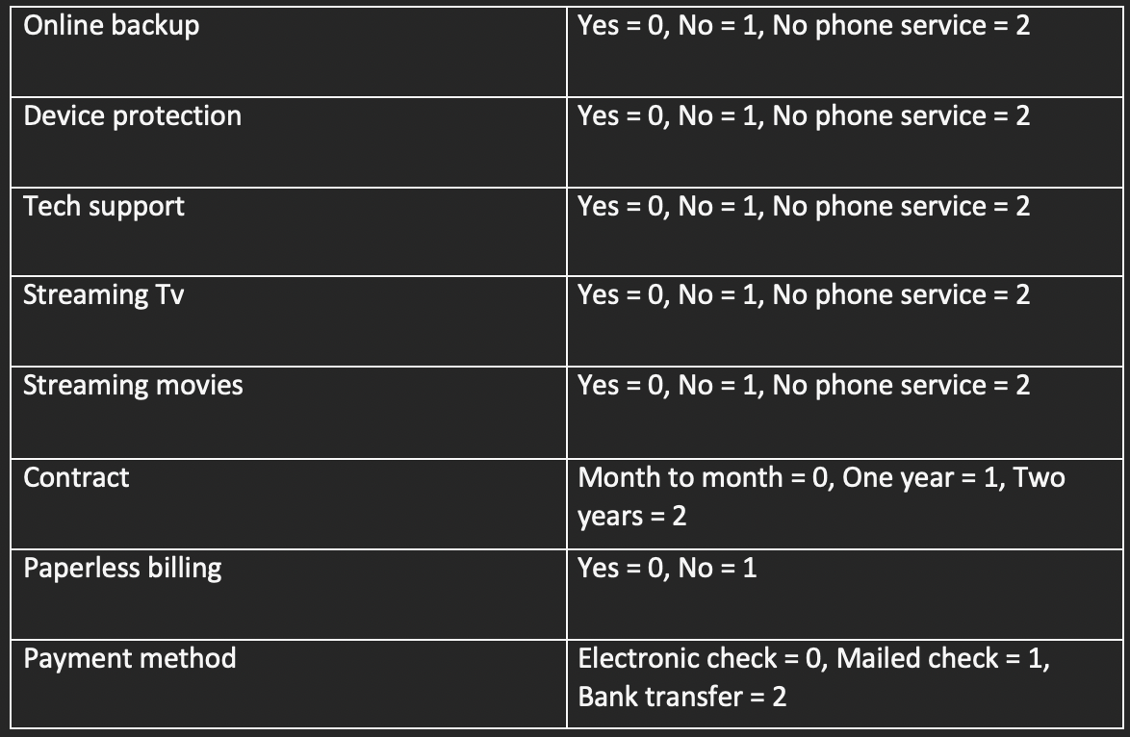
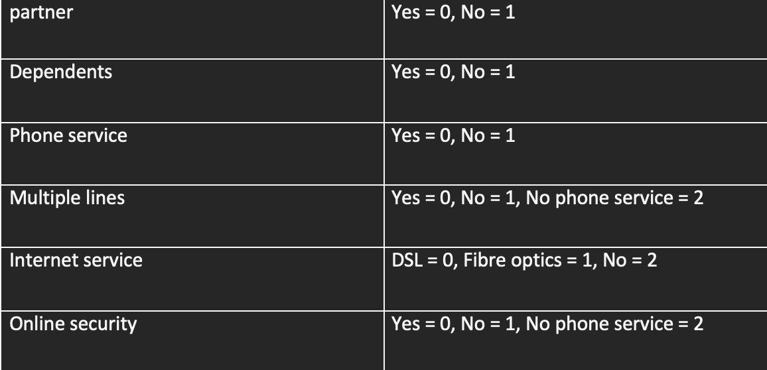
PRE-PROCESSING
Identification of Missing Values
Imputed the missing values with the median value.
Converted the Categorical Variable to numerical Category.
One-Hot Encoding is done on the categorial Variables.

Slide 11
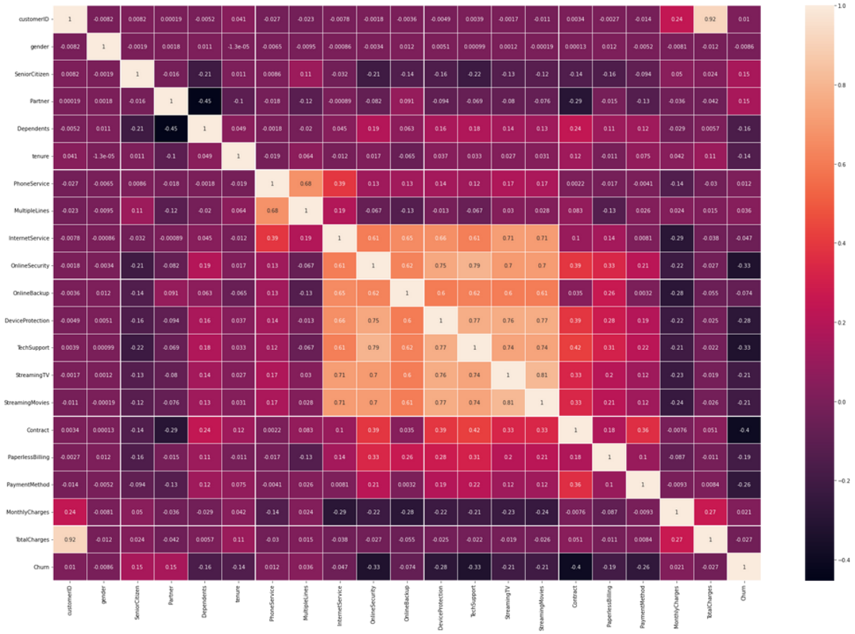
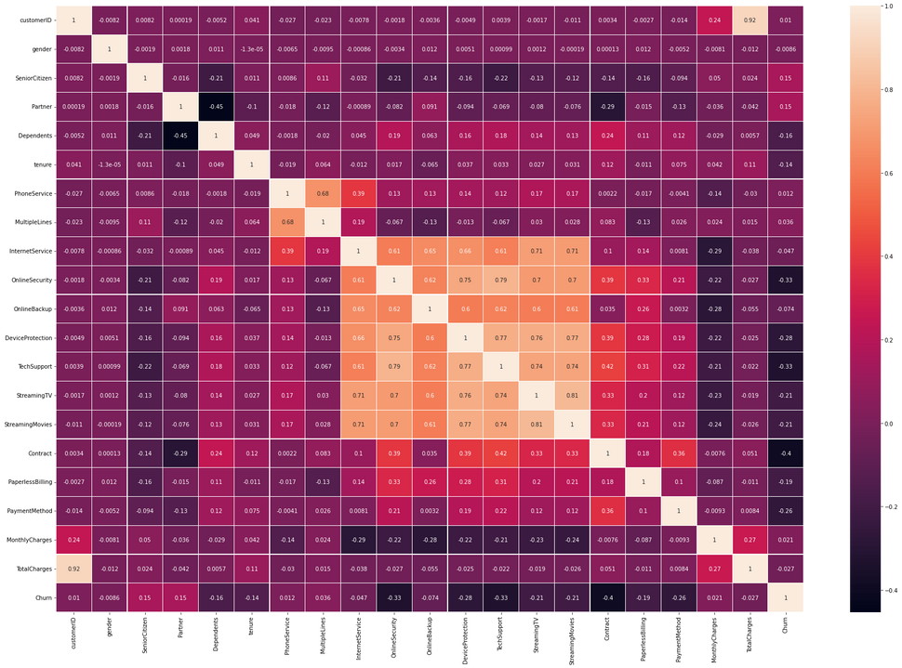
CORRELATION TEST

Slide 12
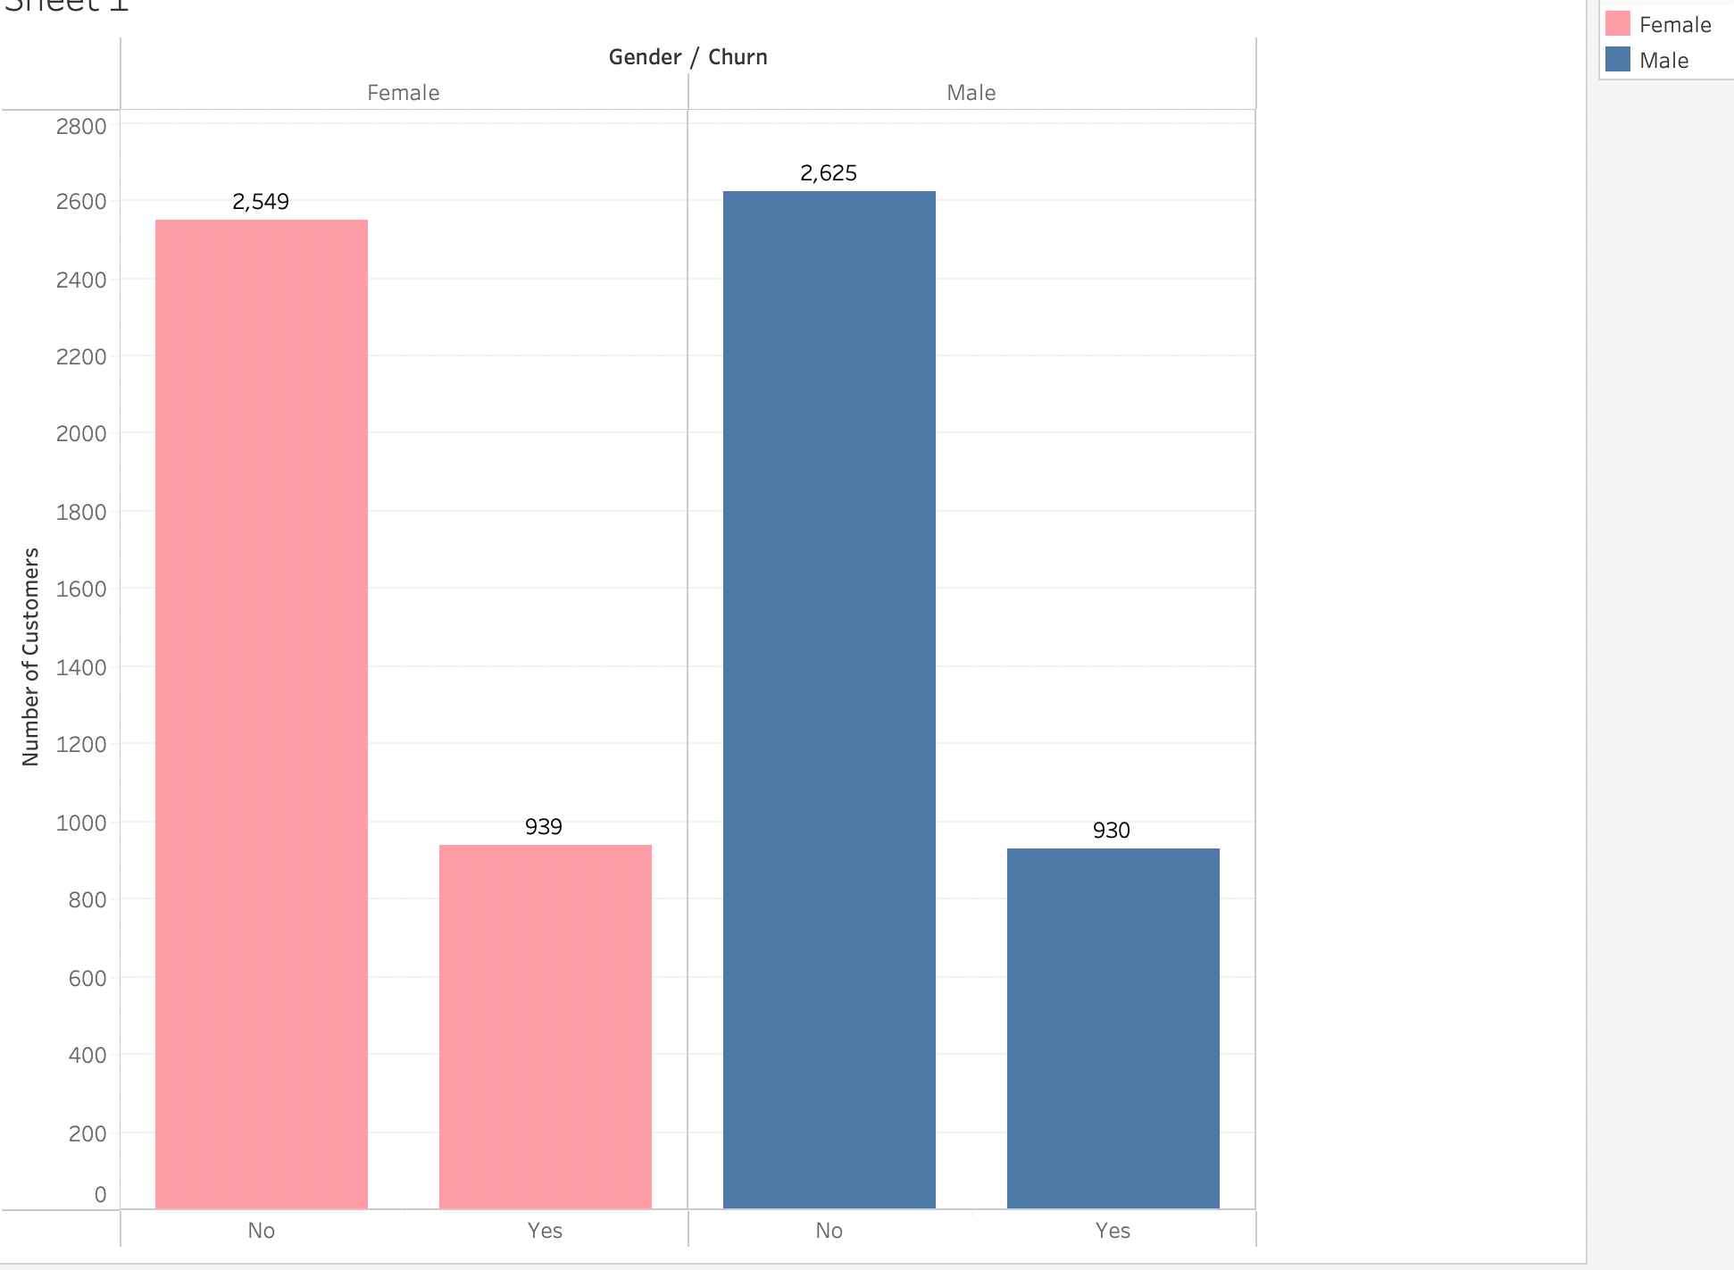
Analysis Using Gender
The bar chart represents the churn data with respect to gender
Out of 3488 female 939 churned
Out of 3555 male 930 churned
Gender does not seem to affect the churn rate

Slide 13
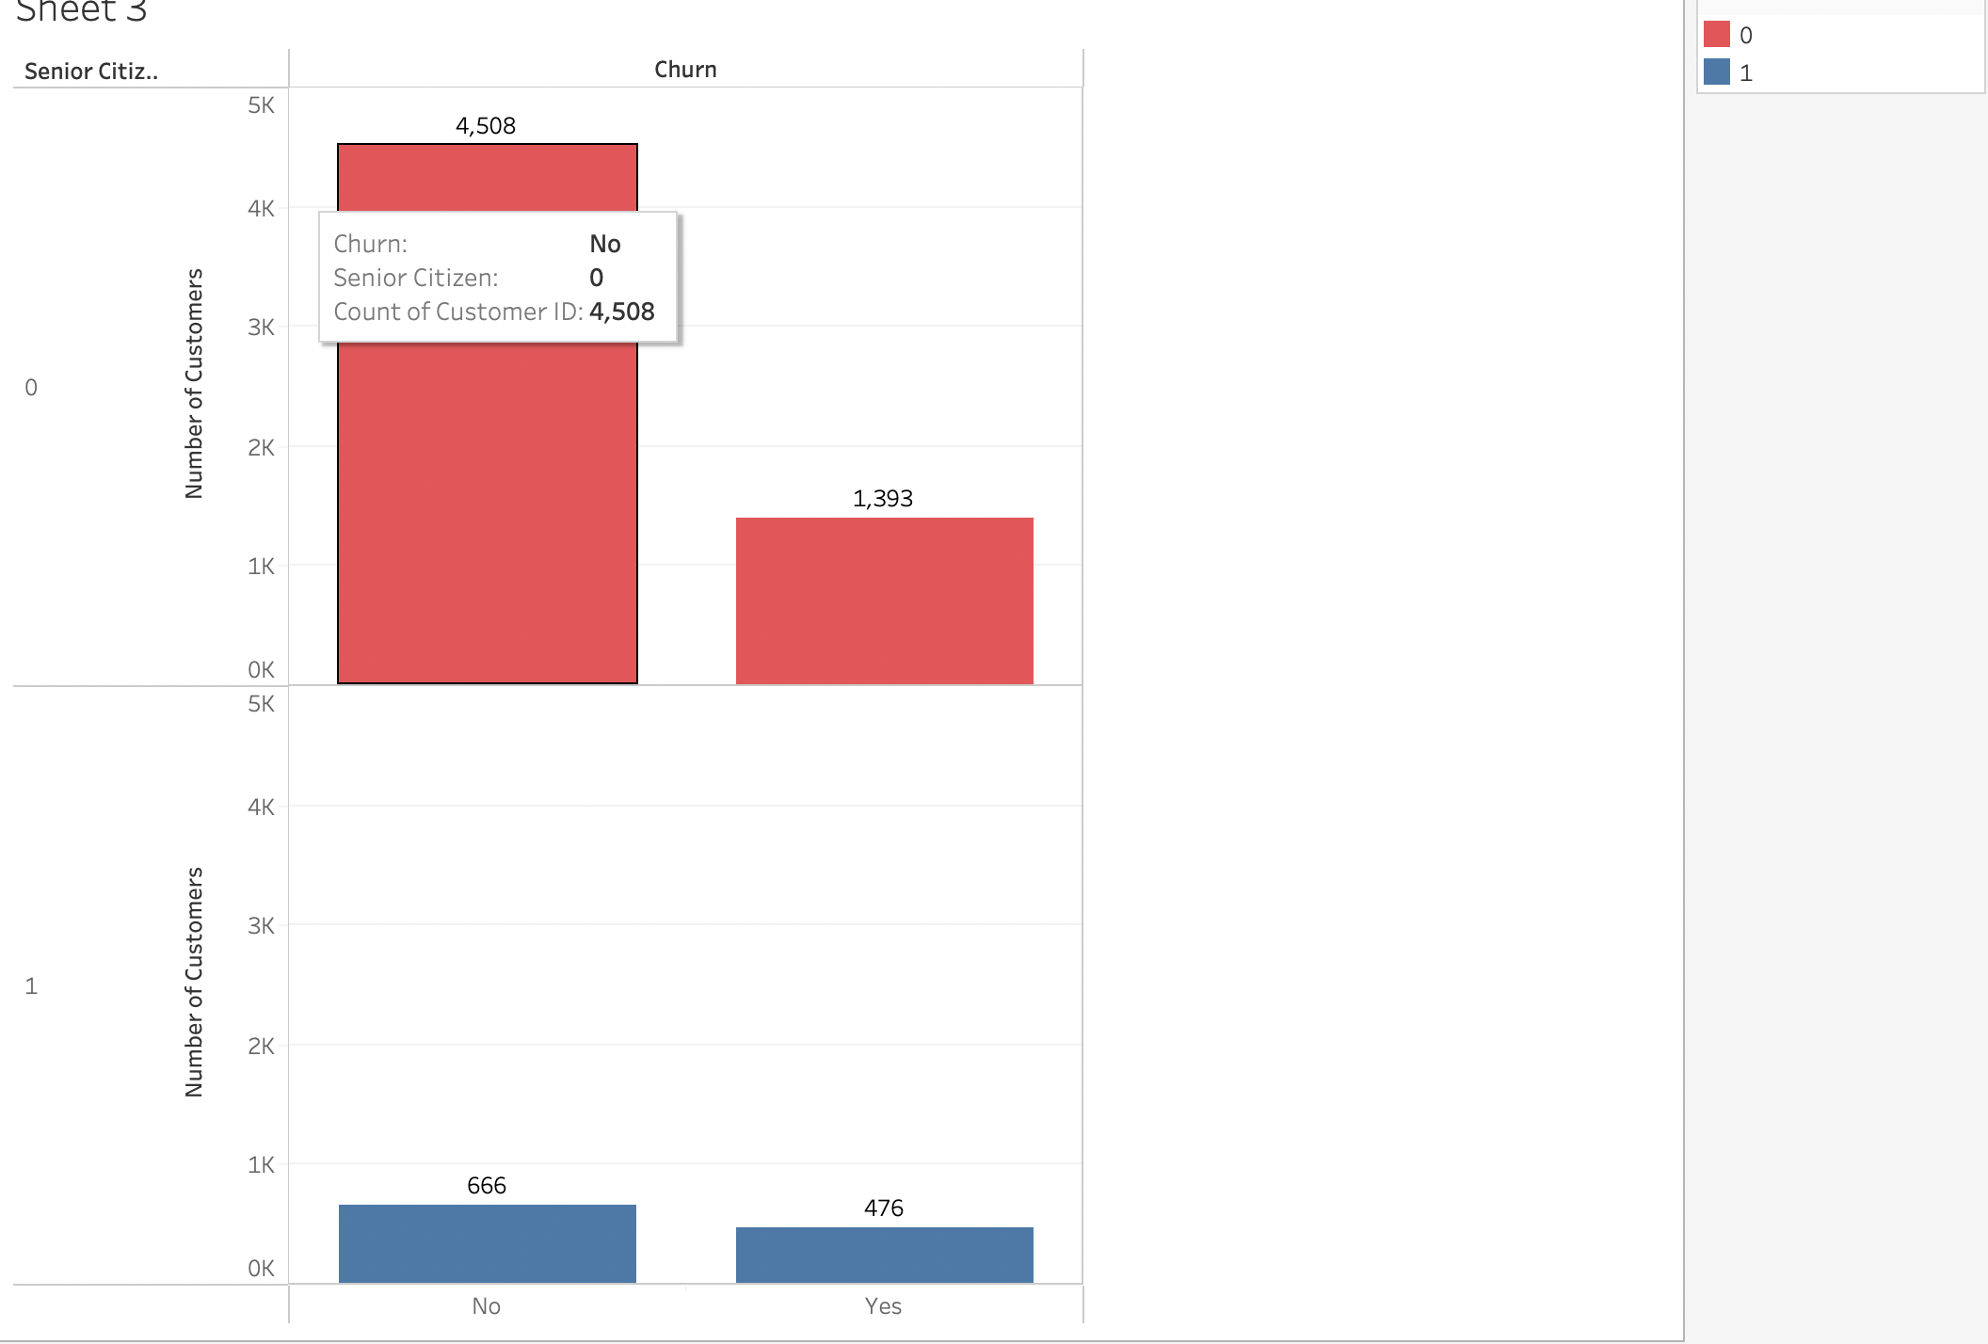
CHURN BY SENIOR CITIZEN
The Senior Citizens accounts for about 16% of the customer segment
out of 1142 customers 476 tend to churn, which accounts for about 42%
The Senior Citizen has higher churn rate than other people
The Churn rate of Non-Senior Citizen people accounts for about 23%

Slide 14
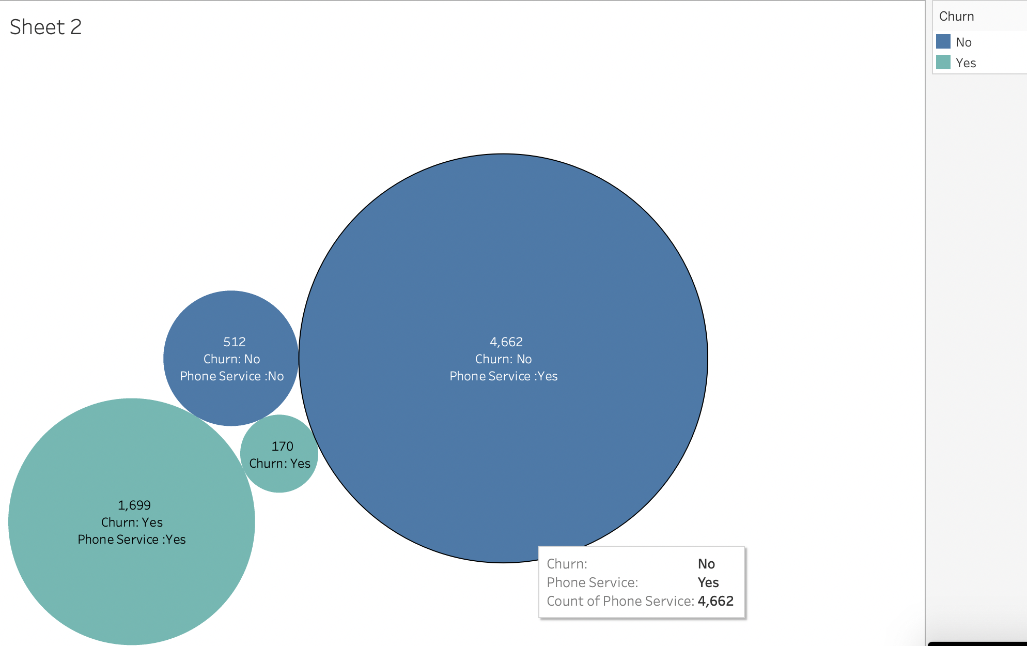
CHURN BY PHONE SERVICE
Of the 7043 customers 682 has no phone service
out of 682 - 170 have churned which is about 24.9%
on the other hand, out of 6316 customers 1699 have churned, which is about 26.8 %
Opting for Phone Service or not does not factor in much for churning

Slide 15
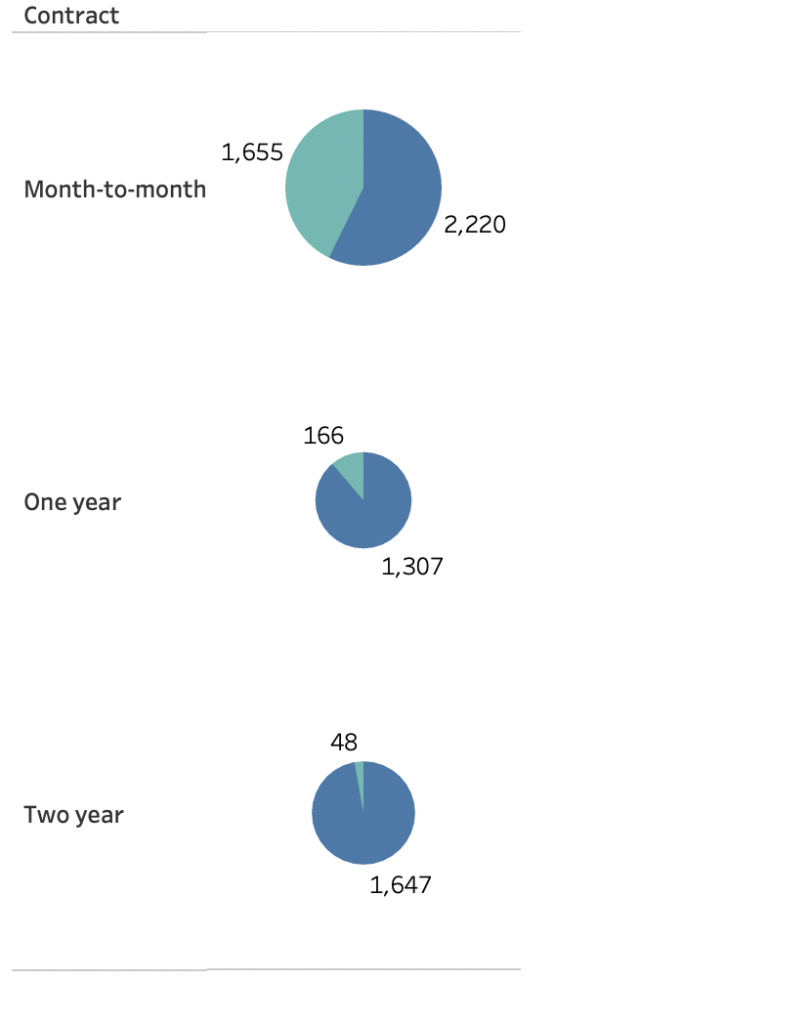
CHURN BY CONTRACT PLAN
The contract plan tend to affect the churn rate drastically
It can be observed that the customers with the month-to-month plan tend to leave easily
The Churn rate is about 42%
The Customers with the 2-year commitment have the lowest churn rate, which is only about 2%
The Customer with one year plan has a churn rate of 11% , which is also much lower when compared to month-to-month.

Slide 16
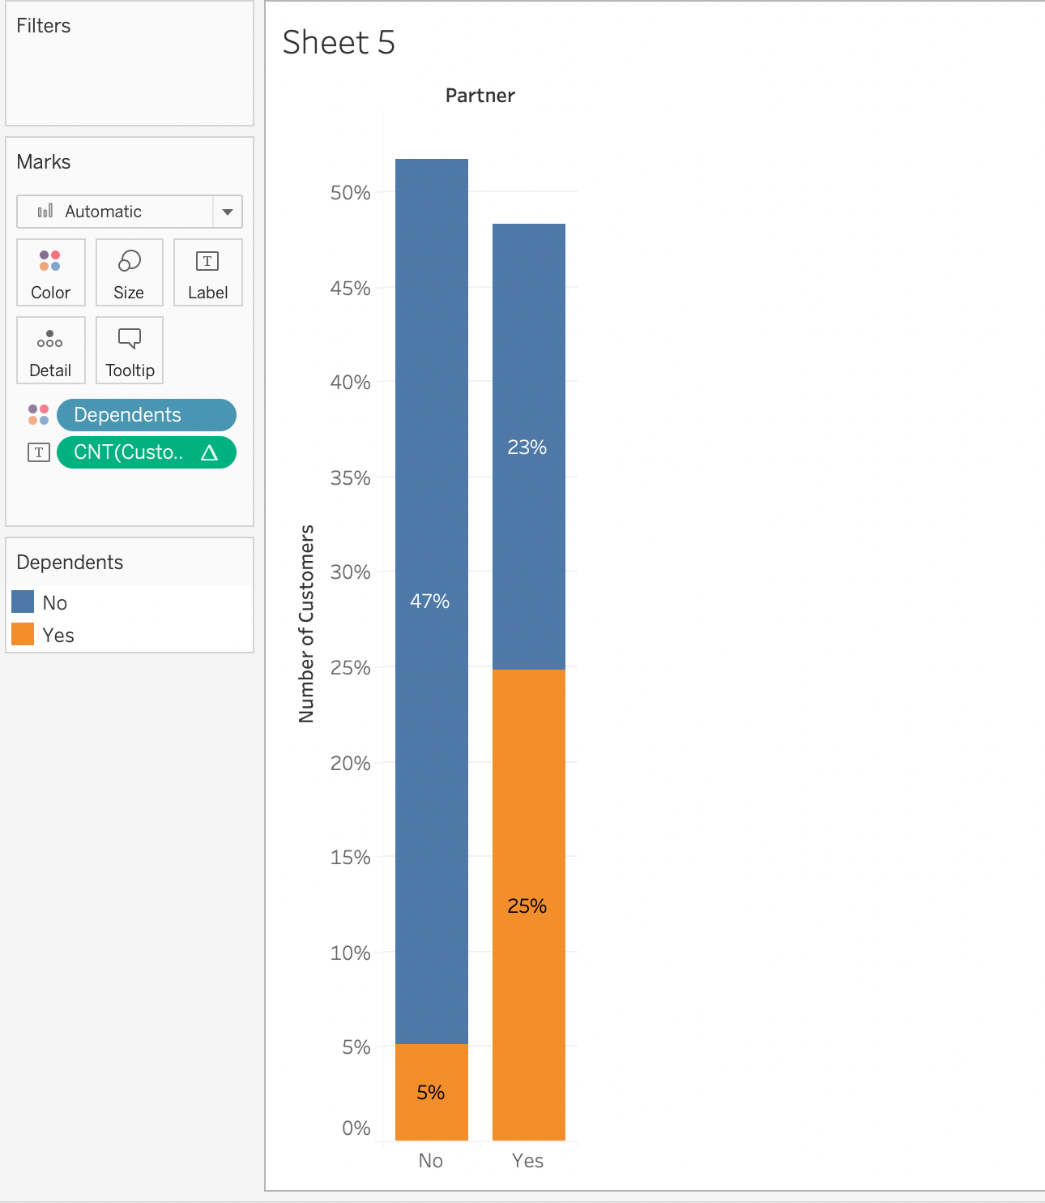
POPULATION ANALYSIS
About 48% of the people do not have partners
Only 30% of the population has dependents

Slide 17
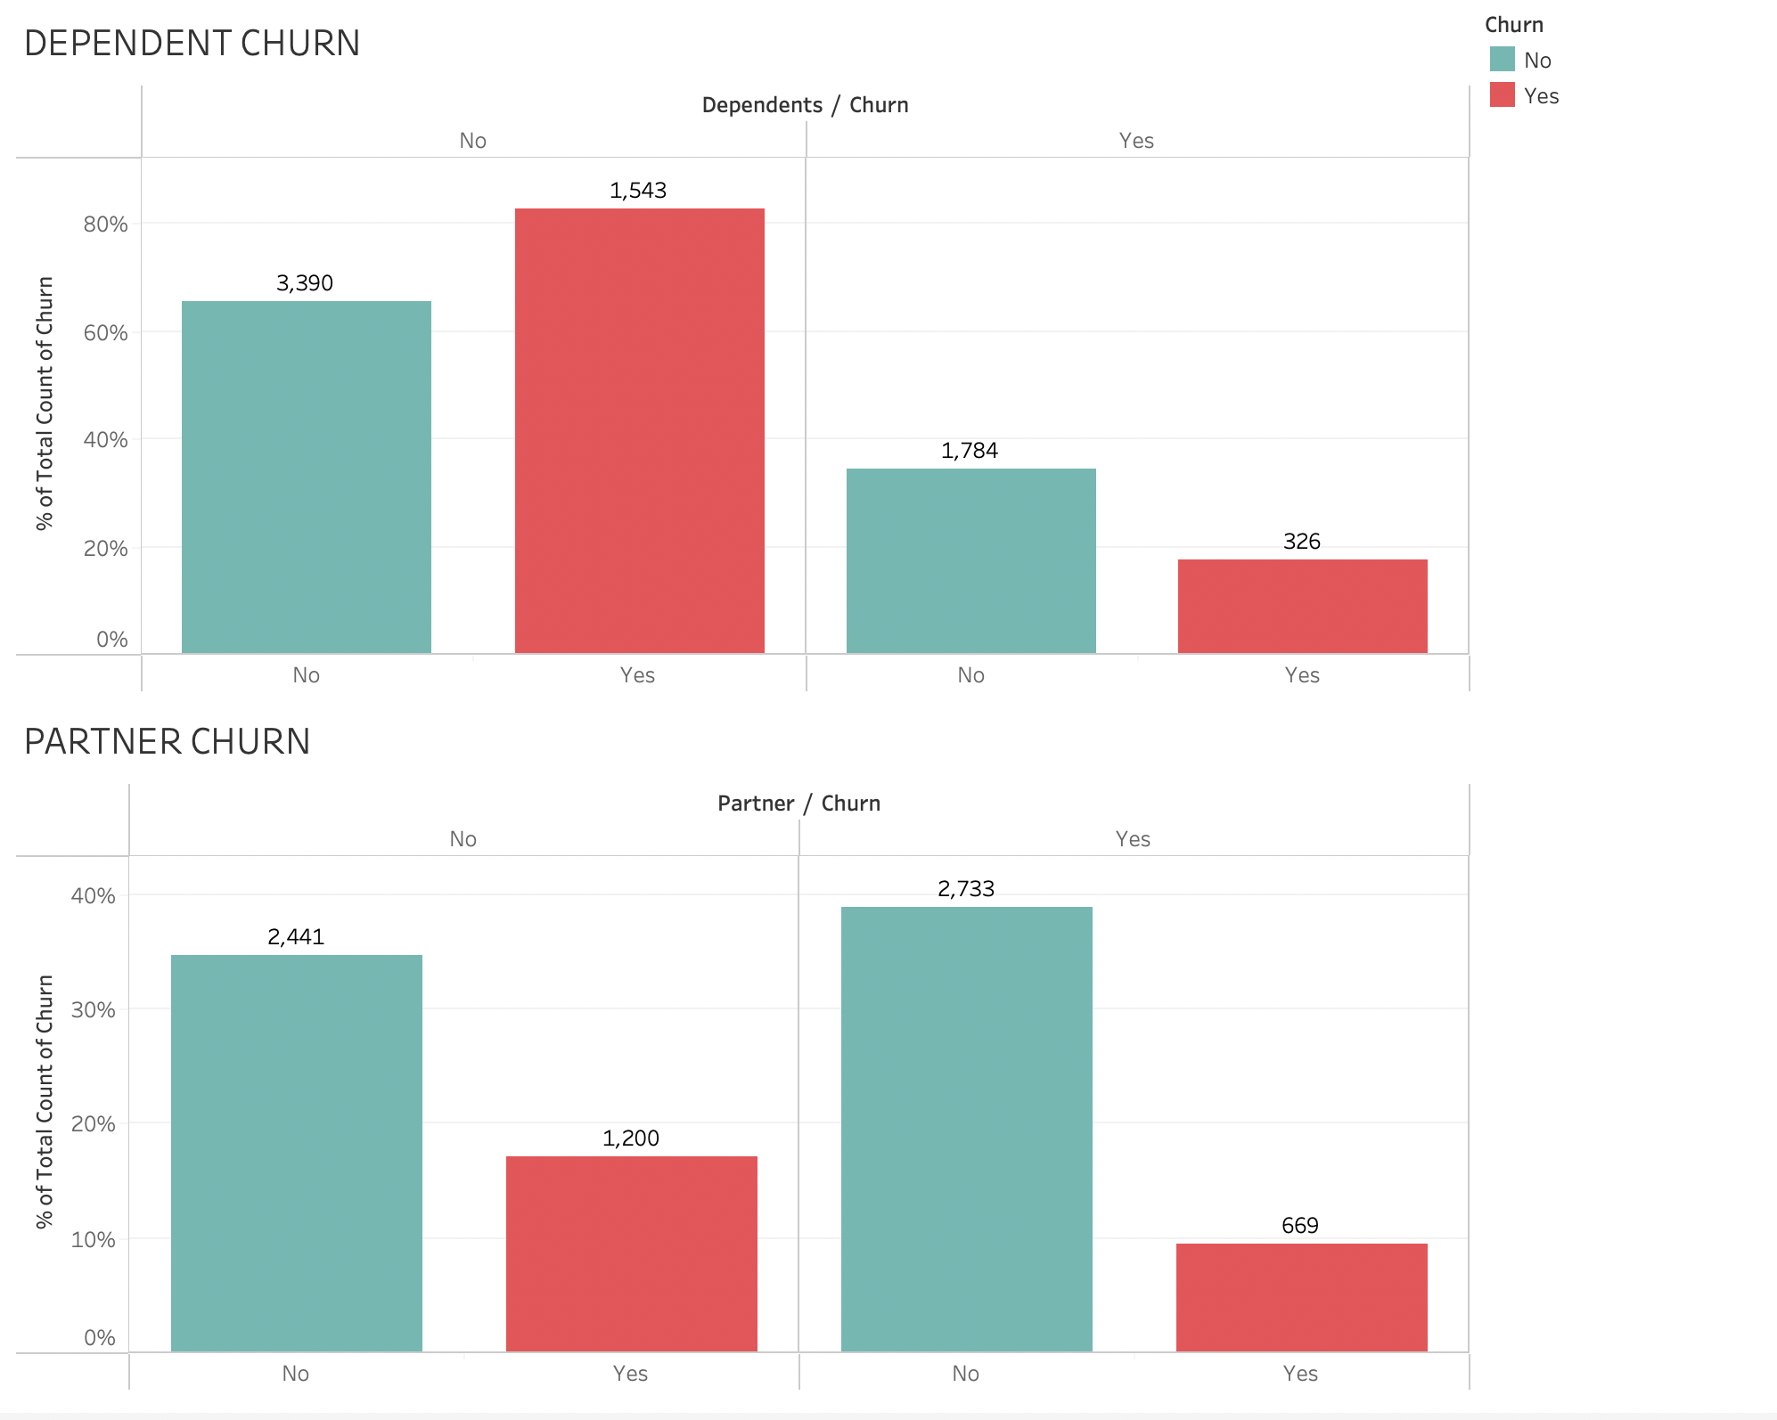
DEPENDENT & PARTNERS
People with no dependents tend to have a higher churn rate of about 31%
while those with dependents have half the churn rate of those who don't
People without partners have higher probability of leaving than with those who have partners.
The Churn rate of those without partners is about 32%

Slide 18
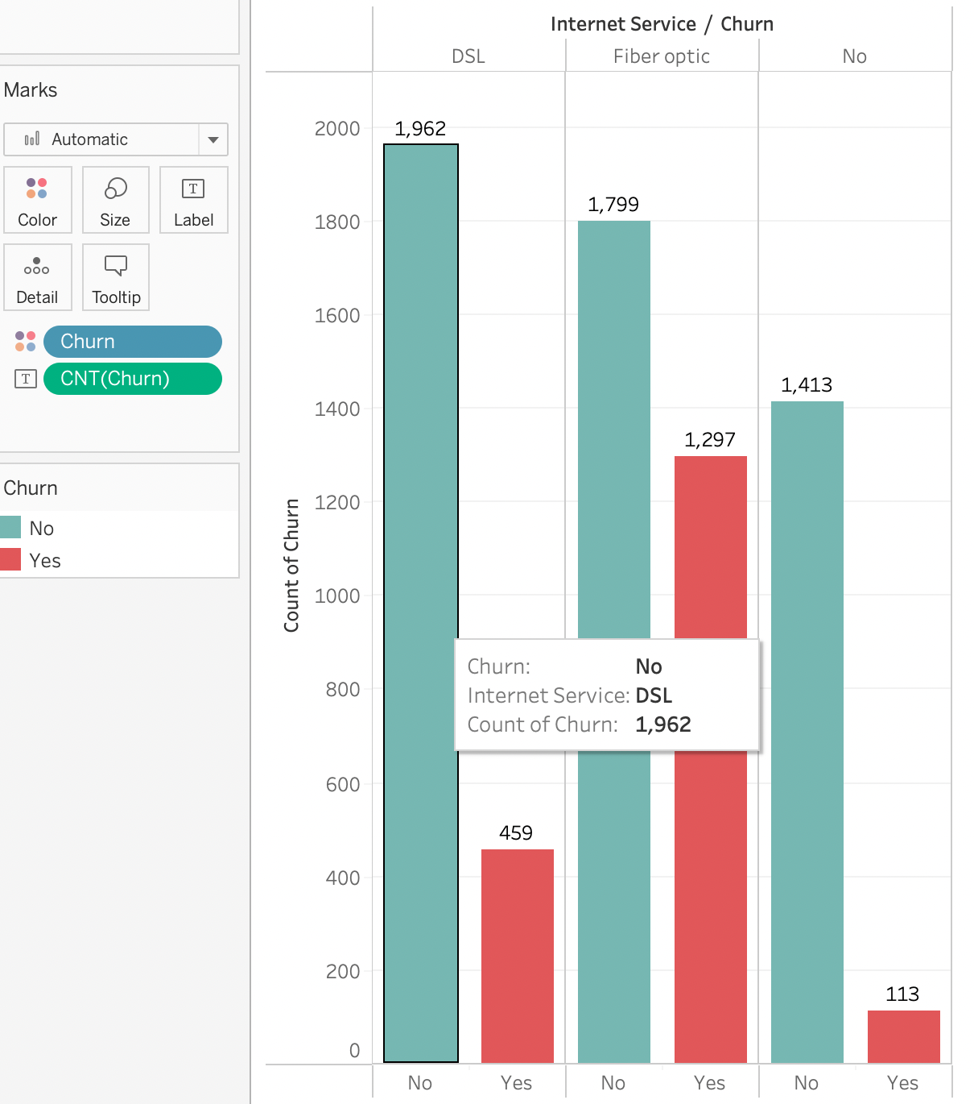
CHURN BY INTERNET SERVICE
Customers with No Internet has lesser churn rate.
There is a huge loss of customers due to the dissatisfaction of Fiber Optic
the churn rate is about 40%

Slide 19
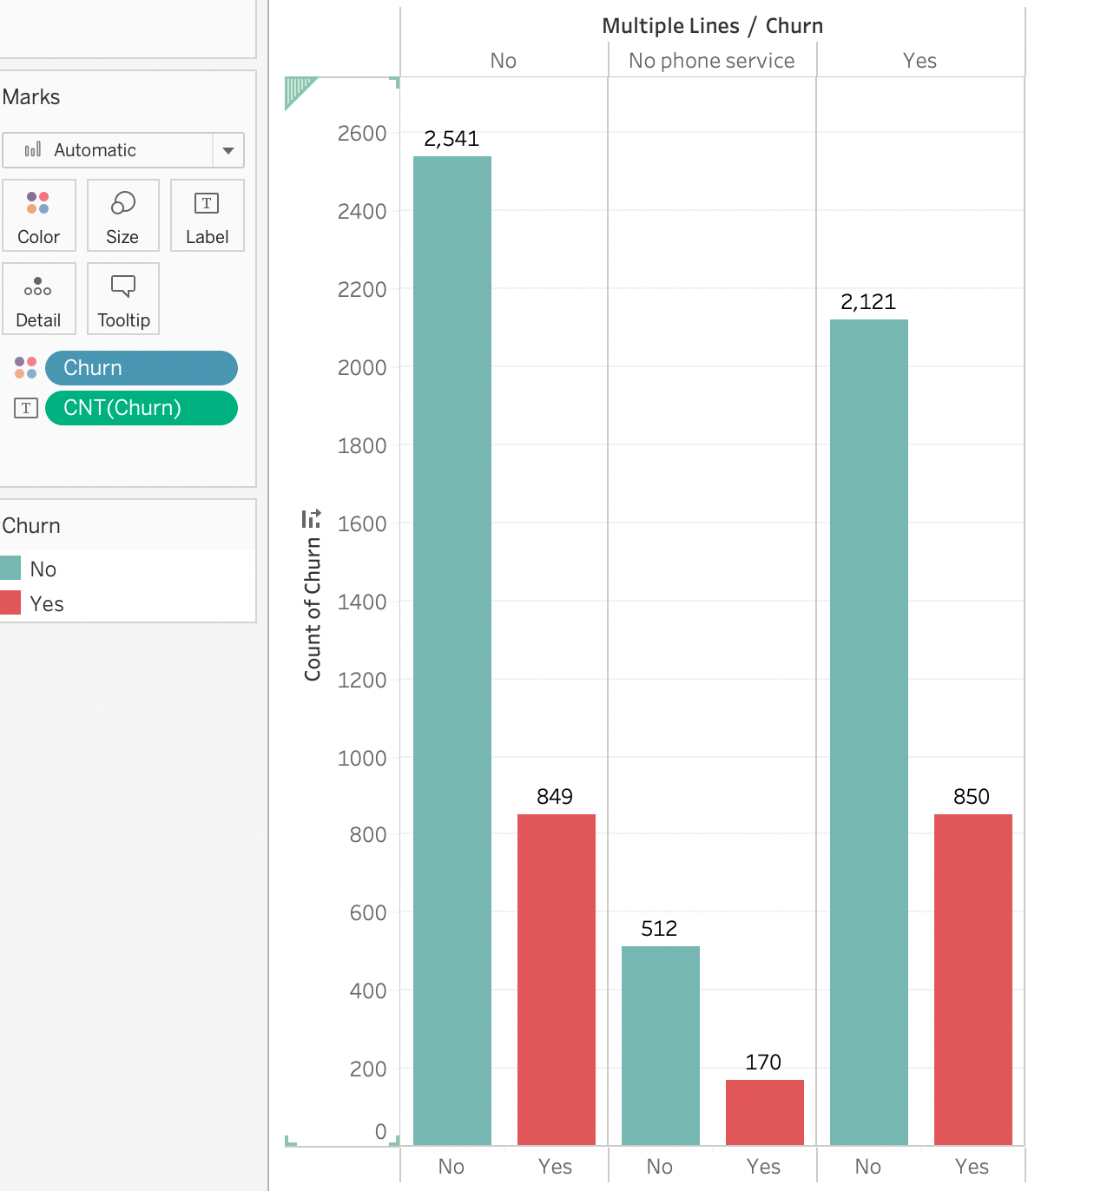
CHURN BY MULTIPLE LINES
The Number of Connections does not seem to factor in for the churn rate
All the categories have a churn rate of approximately 24-25%

Slide 20
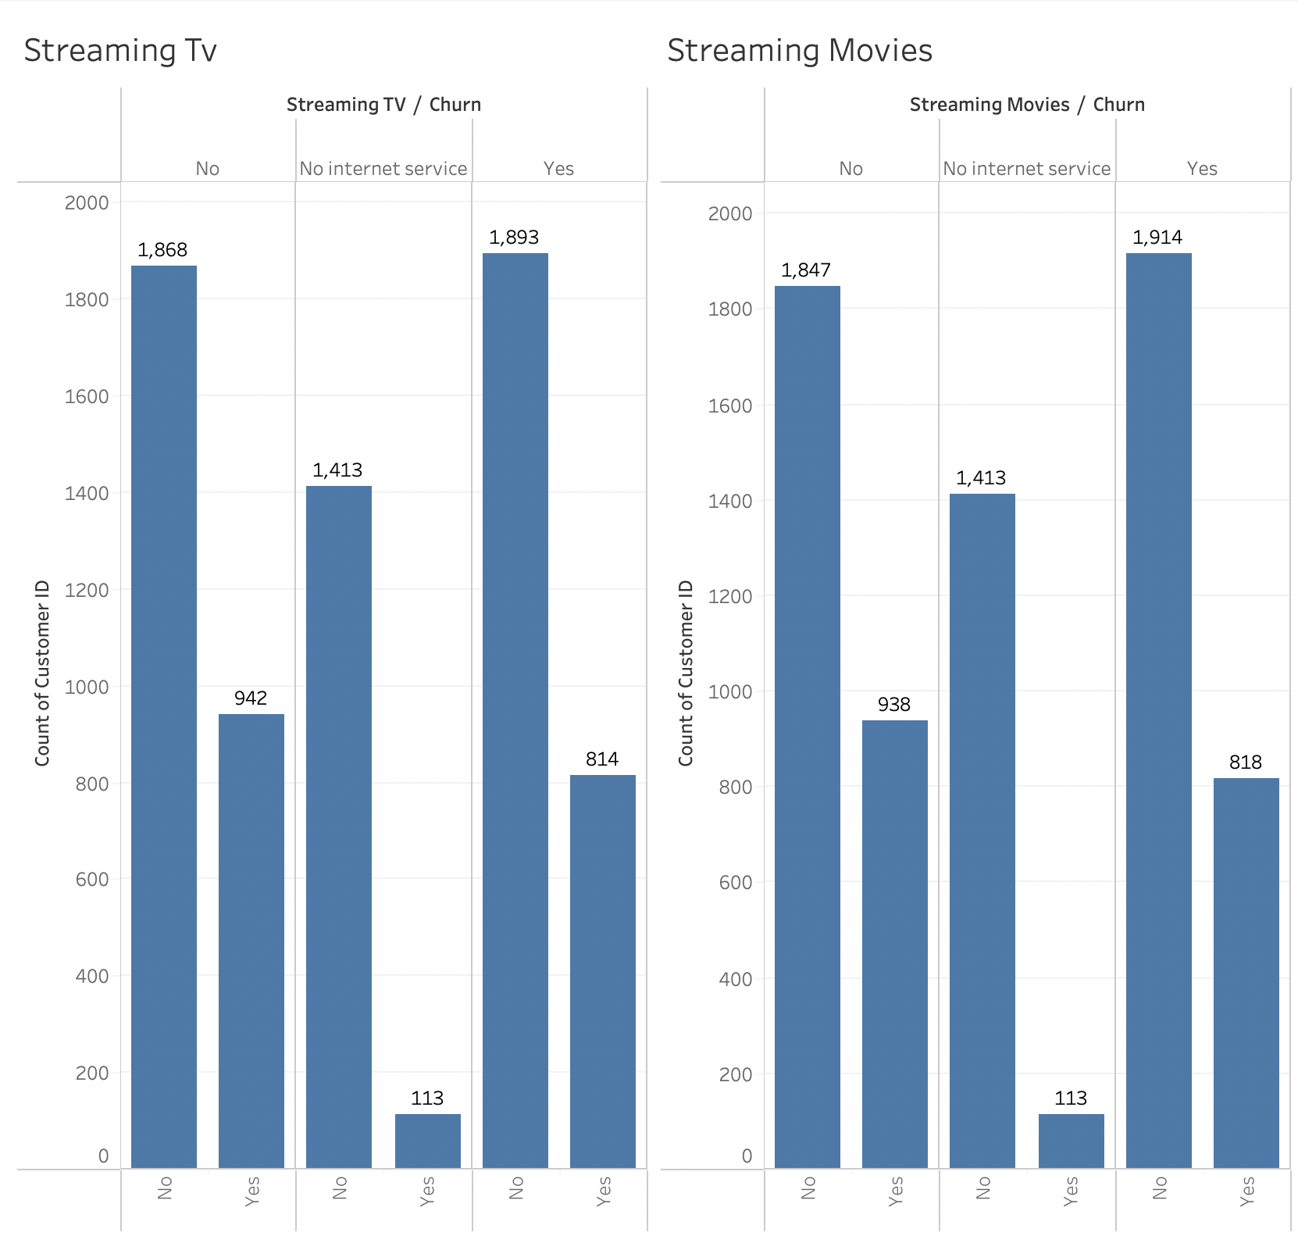
STREAMING SERVICES
About 33% of the people churn, when they don't have TV / Movie streaming
With respect to those who have subscribed for Streaming movies / tv about 30% people churn
The churn rate is low if they do not have the internet service.

Slide 21
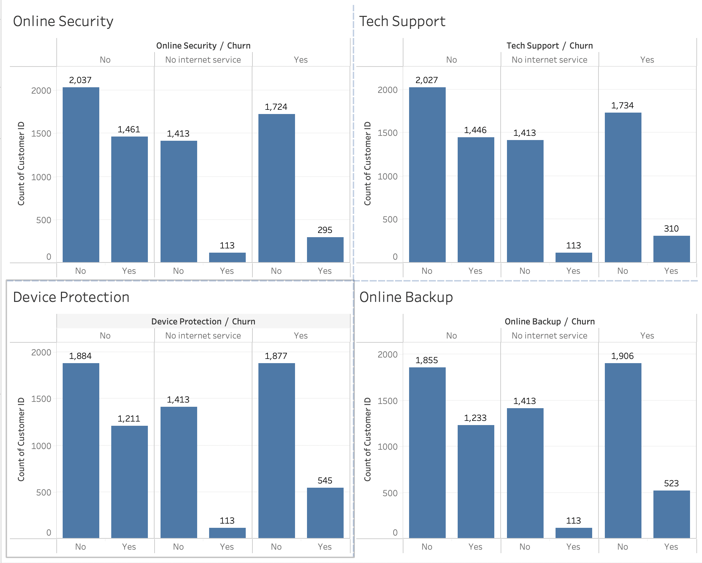
OTHER NOTABLE ANALYSIS
About 41% of the customer who does not opt for online security and those who do not have tech support seems to churn.
About 39% of the people who does not have device protection churned, while about 23% people who have device protection churns.
The Same range of churn rate occurs in online backup too.
Those who do not opt for internet service tend to have low churn rate comparatively in all the cases.

Slide 22
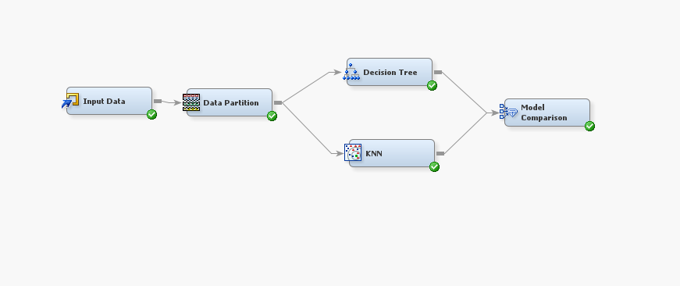
WORKING WITH ALGORITHMS
For Modelling we have worked with three Algorithms
For this purpose, we have taken SAS Enterprise Miner.
The Excel Data is imported to the Input Data.
The Data Partition is split as 80% - Training
10% - Validation
10% - Test
Classification Tree and K-nearest neighbors, Logistic Regression are modelled with the churn data.
The Model Comparison node compares both Decision Tree and KNN model and suggest the best one.

Slide 23
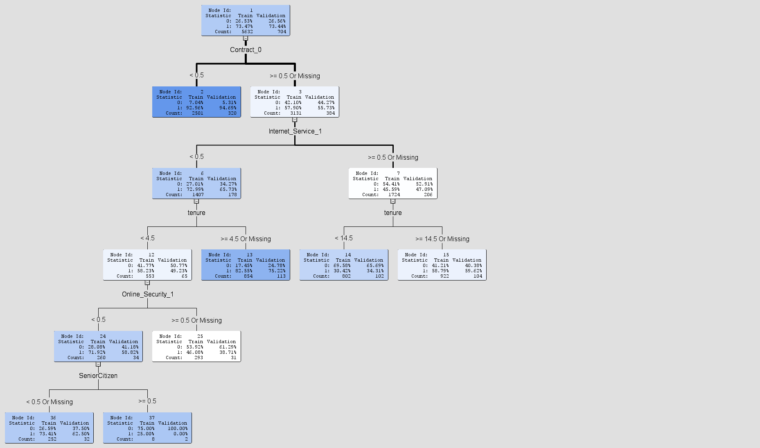
CLASSIFICATION TREE
The Training data’s and the validation data’s churn percentage and the splits is given.
The Classification Tree is calculated based on the GINI index.
The Contract_0 represents the people who opted month-to-month plan, on which the first split occurs.
< 0.5 are the people who opted one-year and two-year plan.
Internet Service_1 represents the fiber optic category.
Tenure is the number of months they have been the customer to the company.
Online_Security_1 represents the category of people who have not opted for Online Security.
Senior Citizen is a binary variable of 0/1.

Slide 24
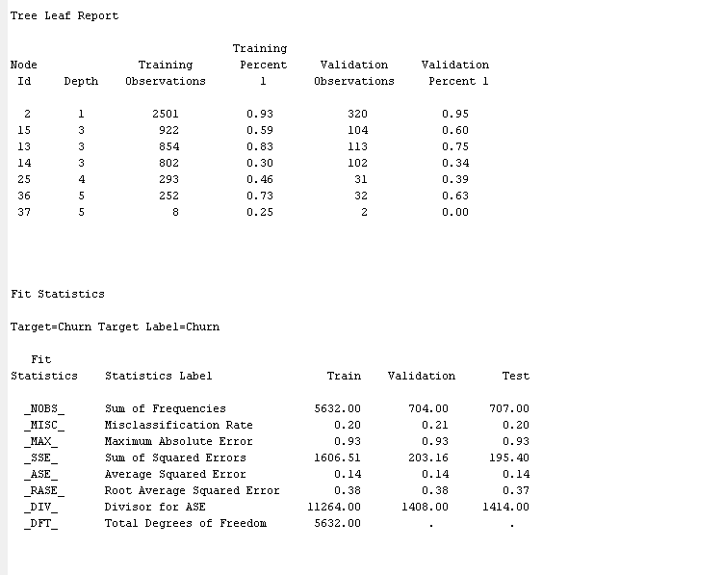
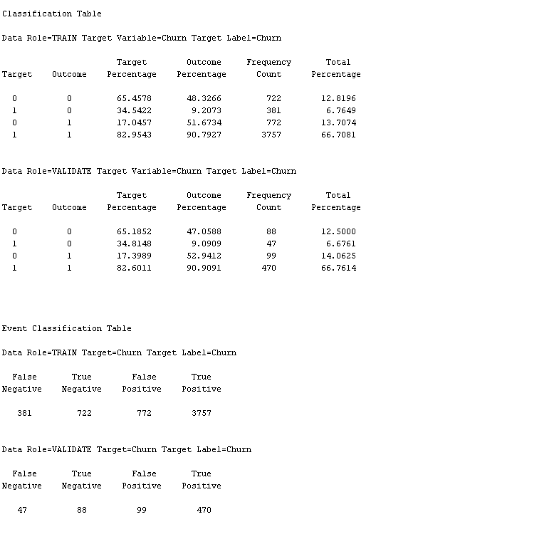
MODEL FIT STATISTICS

Slide 25
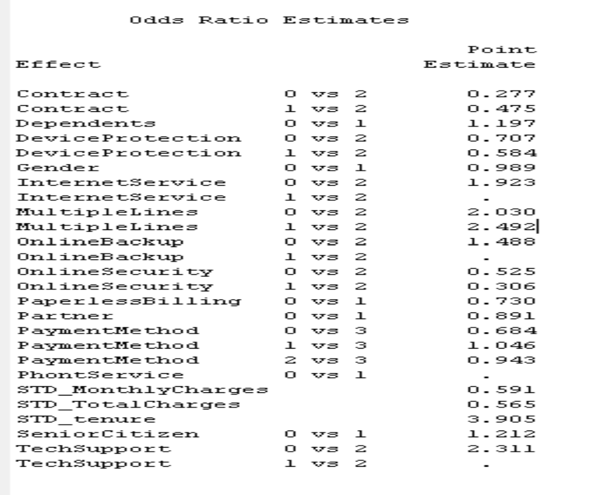
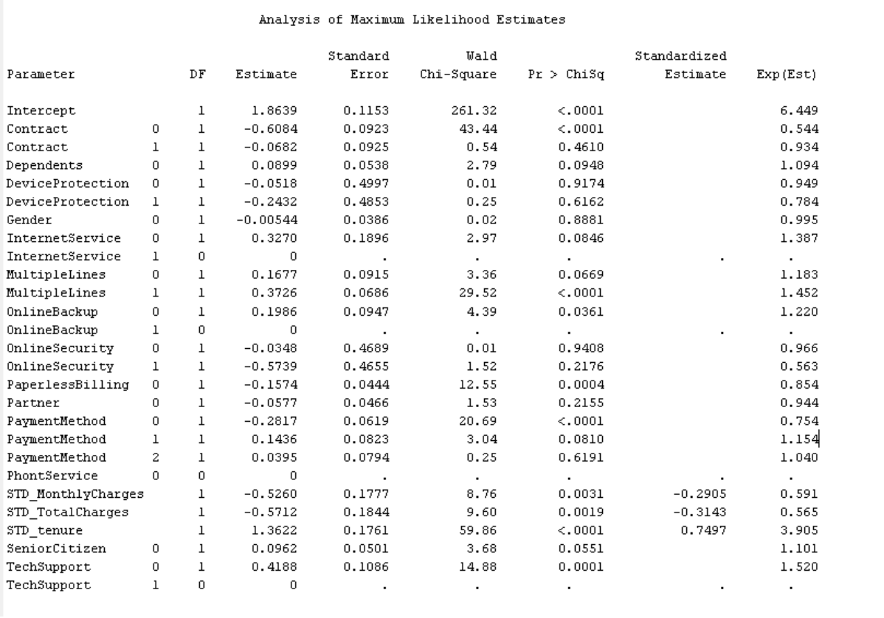
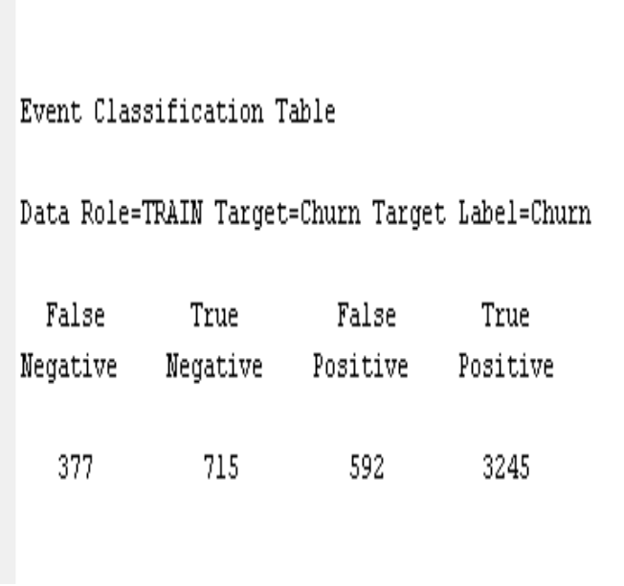
LOGISTIC REGRESSION
we found out that contract, tenure, online security are the three most important factors affecting customer churn according to Wald Chi-Square statistics.
Accuracy:
TP+TN/FN+TN+FP+TP
3245+715/377+715+592+3245 = 0.8034. = 80.34%
This means 19.66% of the customers are getting misclassified.

Slide 26
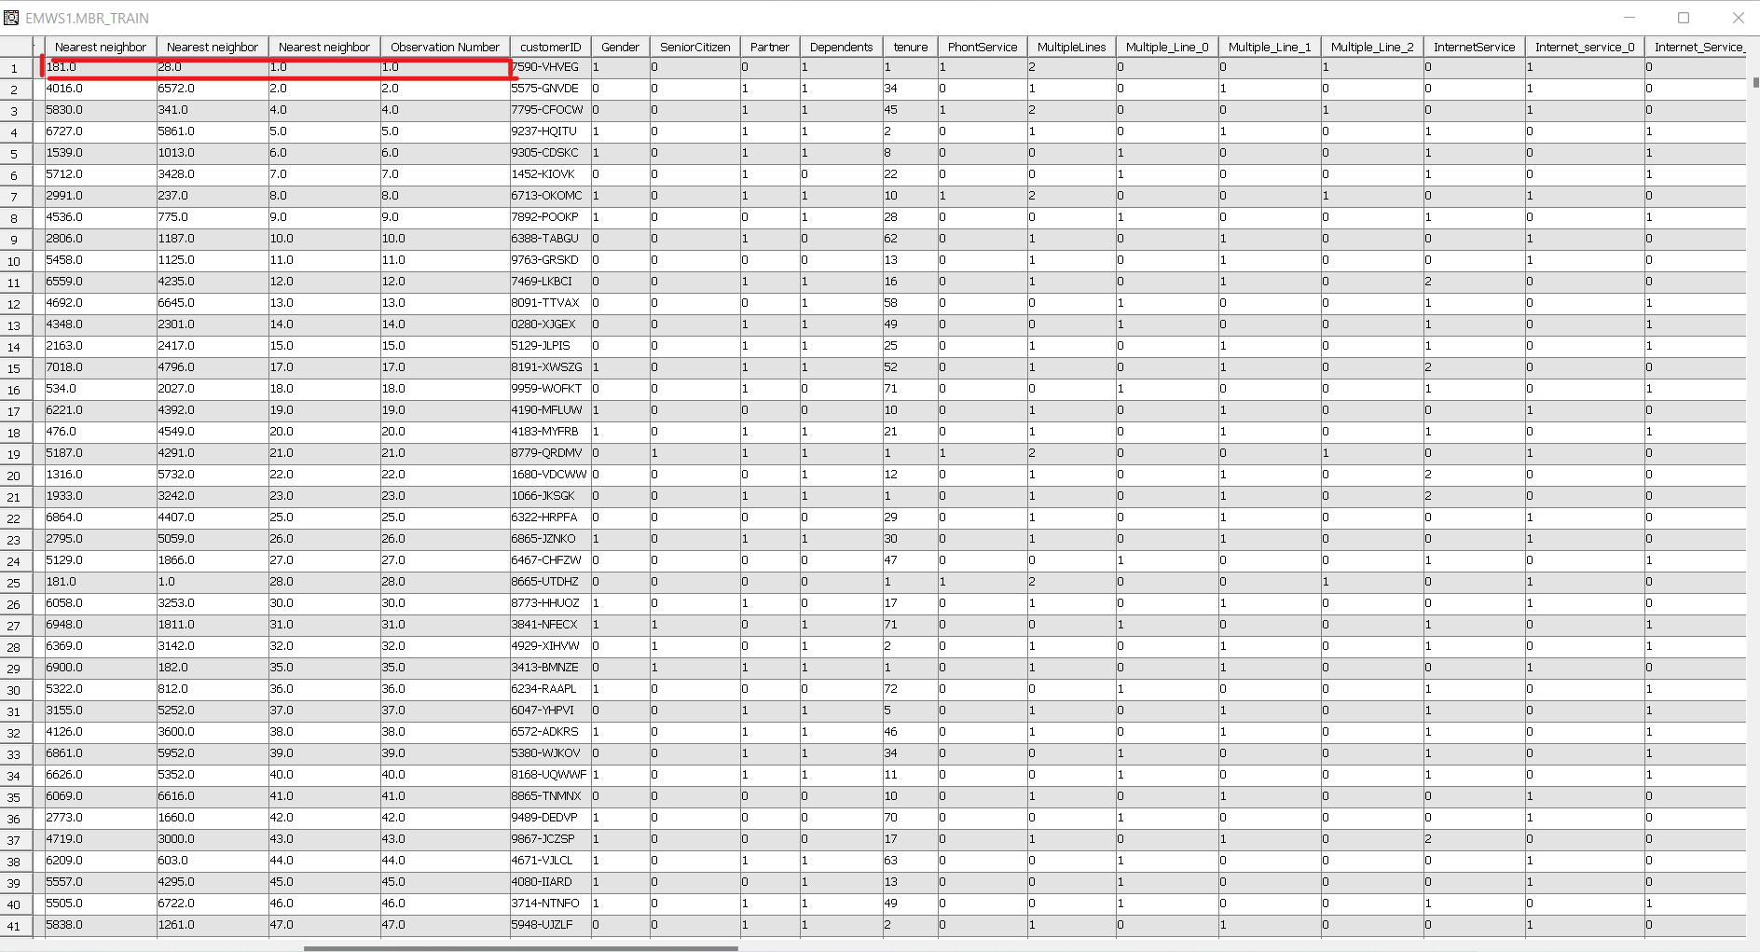
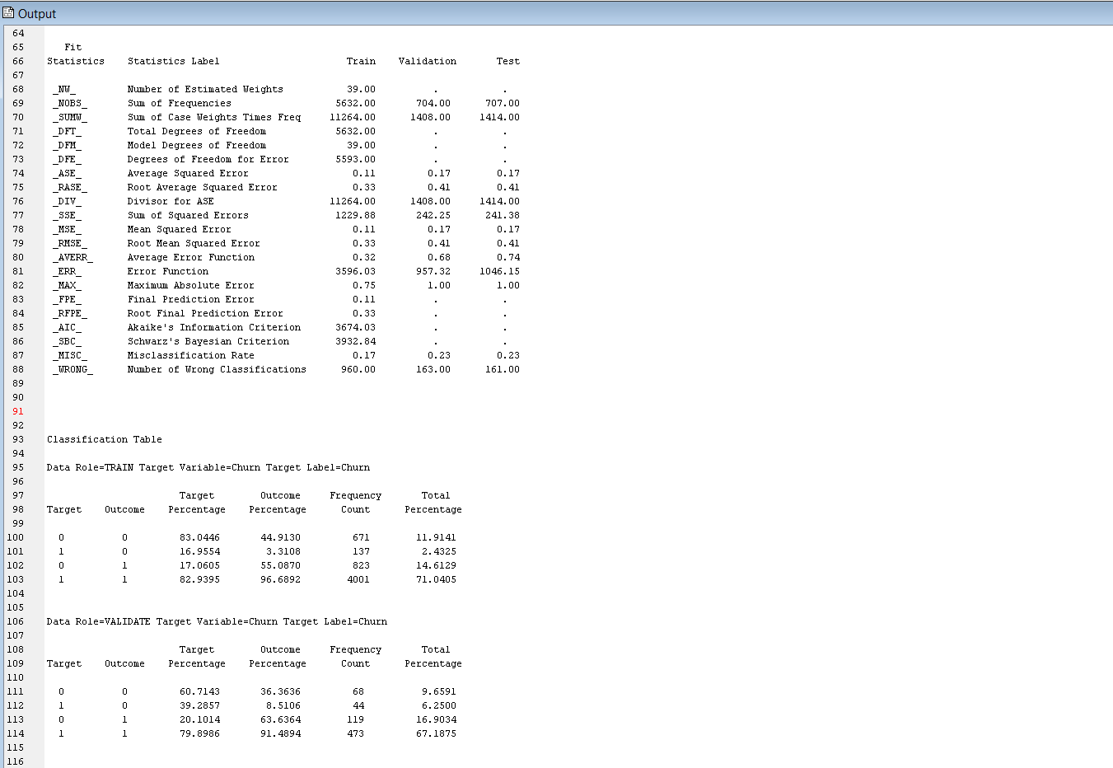
K-NEAREST NEIGHBOR
The K-nearest neighbor, groups the data points based on how close the other data points are with them.
For this model 4 nearest neighbors are calculated.
Since any data point has the shortest distance to itself , it is taken into account as one of the neighbors.
The Domain experts will be able to tell us the best k-value
Since the misclassification rate is 0.17 for this model (training data), we stopped here.

Slide 27
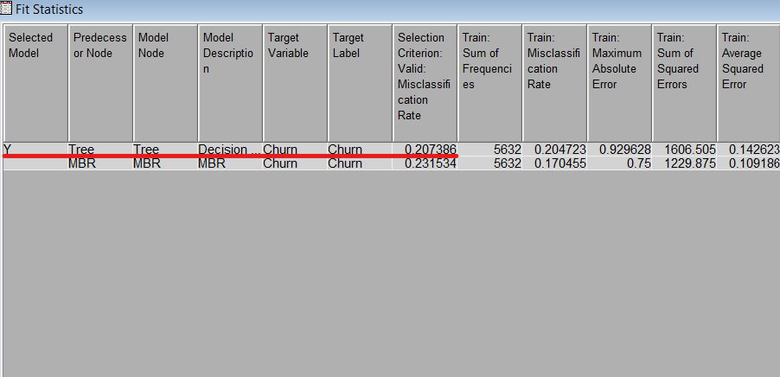
MODEL COMPARISON
Out of the two models, the DECISION TREE is taken as the best model. The Selection Criterion is the Misclassification Rate of Validation Data. Which is about 0.20

Slide 28

REAL WORLD EXAMPLES
Leading Telecom Companies like AT & T put in a lot of efforts to predict churn and come up with the business plan to attract customers
The Company has research labs in order to understand the customer population
Massive Data Generation - over 100M mobile devices, millions of IPTV customers, the largest Wi-Fi network in the US, and the network backbone that connects the entire internet.

Slide 29
REAL WORLD EXAMPLES _ CONTD
The main research areas are
Recommender Systems - predict items that a customer may like
Customer Experience Modeling - use statistical models/classifiers, text analysis, custom survey research, and GIS data mining to glean insights about our customers' experience with the services
Human Mobility - studying data from mobile phone networks to understand how people live, work, and move.

Slide 30
RESULTS
Customer retention is one of the important part of profitable business
The forerunners of the industry are now using analytics to serve the purpose
Customer Behavior is complex and should be known to some extent for making business plans.
Customer Churn Prediction is the foundation from where we can build the analytics

Slide 31
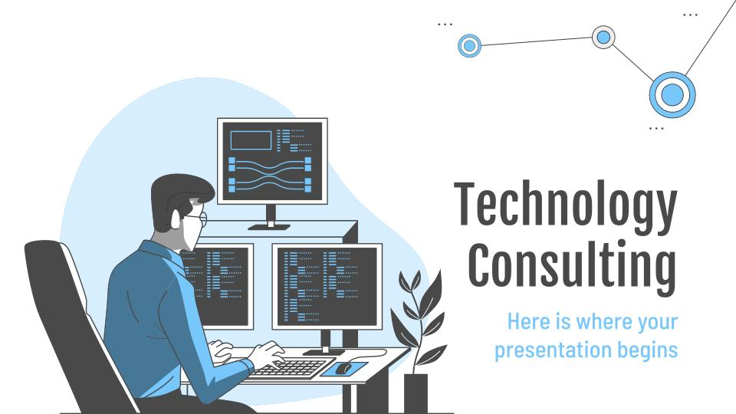
RECOMMENDATIONS
Plan to convert month-to-month customers to longer contract
Campaigns / offers attracting senior citizens
Quality in Fiber Optic should be improved where churn rate is high

Slide 32
RECOMMENDATIONS
Improvement on the Technical support on all services like streaming
Exclusive offers for at least till 20 Months for retention plans

Slide 33
CITATIONS
https://www.kaggle.com/blastchar/telco-customer-churn
https://scholar.google.com/scholar?q=At%26t+churn+prediction&hl=en&as_sdt=0&as_vis=1&oi=scholart
http://stats.research.att.com/research.php
https://www.sciencedirect.com/science/article/pii/S1877050920306529

Slide 34
HAPPY ANALYZING :)

